Slide 1
Industrial Management

Slide 2
What Is Management?
Management is a set of activities that direct at an organization’s resources with the aim of achieving organizational goals in an efficient and effective manner.

Slide 3
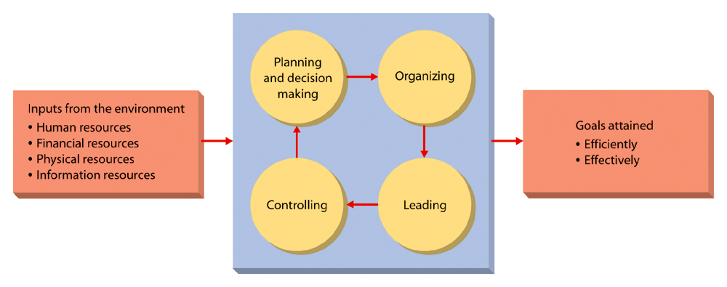

Slide 4
Efficiency
By efficient, we mean using resources wisely and in a cost effective way.

Slide 5
Effectiveness
By effective, we mean making the right decisions and successfully implementing them.

Slide 6
Give an example of a decision situation that is
Efficient but not Effective
Effective but not Efficient
Both Efficient and Effective
neither Efficient nor Effective

Slide 7
Functions of Management
Planning
Planning is deciding in advance what is to be done
It is the future course of action
It is the first and foremost task of management
It includes:
establishing goals and standards,
developing rules and procedures,
developing plans and forecasting.

Slide 8
Decision Making
act of choosing one alternative from among a set of alternatives

Slide 9
Decision Making process
Recognizing and Defining the Nature of a Decision Situation
Identifying Alternatives
Evaluating Alternatives
Choosing the "best" Alternative
Putting it to Practice
Follow-up

Slide 10
Decision Making Conditions
Certainty
A conditions in which the decision maker clearly knows the potential payoffs and costs

Slide 11
Decision Making Conditions
Risk
A conditions in which the potential payoffs and costs are all associated with probability estimates

Slide 12
Decision Making Conditions
Uncertainty
A conditions in which the decision maker does not know the potential payoffs and costs

Slide 13
The Decision Making Conditions
Certainty
Risk
Uncertainty
Level of ambiguity and chances of making bad decision
lower
Moderate
Higher

Slide 14
Organizing
determining how activities and resources are to be grouped
Basic elements:
job design
departmentalization
authority relationships
span of control
line and staff roles

Slide 15
Leading
The set of processes used to get members of the organization to work together to further the interests of the organization
Activities and processes:
motivating employees
influencing others
managing interpersonal relations and communication
managing work groups and teams

Slide 16
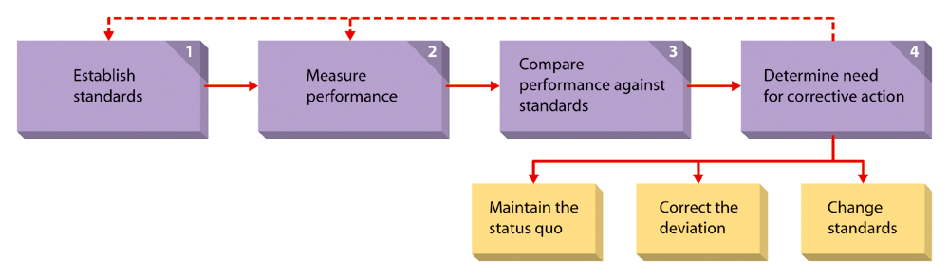
Controlling
monitoring organizational progress toward goal attainment

Slide 17
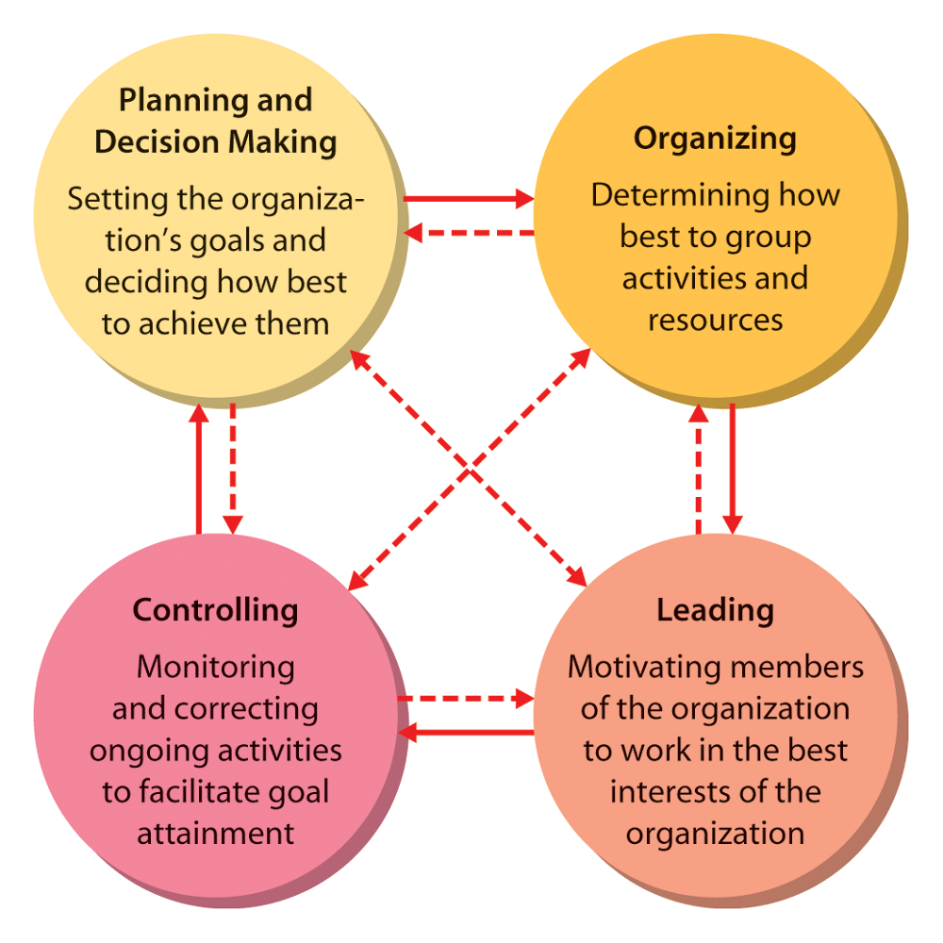
The Management Process

Slide 18
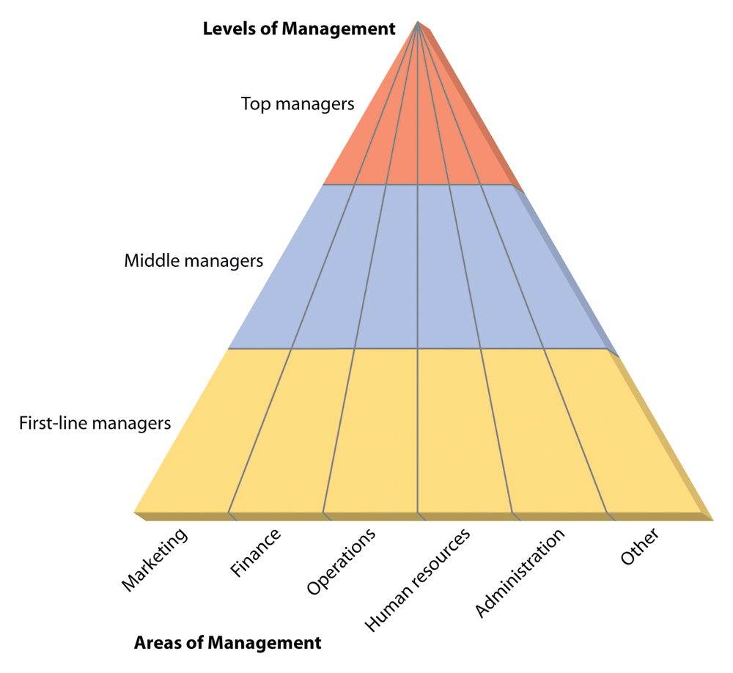
Levels and Areas of Managers

Slide 19
Top Managers
The small group of executives who manage the overall organization, the strategic level

Slide 20
Top Managers
Title:
President
Vice President
Chief Executive Officer

Slide 21
Top Managers
Their functions and responsibilities are diverse and varied
making strategy
policies & plans
representing organizations

Slide 22
Middle Managers
The largest group that implements the strategies developed at the top and coordinates and supervise the activities of the first line managers

Slide 23
Middle Managers
Titles:
operations managers
divisional heads
regional managers

Slide 24
First-Line Managers
Supervise and coordinate the activities of operating employees

Slide 25
First-Line Managers
Titles:
coordinator
supervisor

Slide 26
Fundamental Management Skills
Technical Skills
Necessary to accomplish or understand the specific kind of work being done
These skills are especially important for first line managers

Slide 27
Interpersonal Skills
The ability to communicate with, understand, and motivate both individuals and groups
Be able to get along with: Subordinates, Peers, and Those at higher levels

Slide 28
Conceptual Skills
Ability to think in the abstract
Understand organizational goals and its environment
How the organization is structured
Viewing the organization as system

Slide 29
Diagnostic Skills
Skills that enable a manager to visualize the most appropriate response to a situation

Slide 30
Communication Skills
Abilities both to effectively convey ideas and information to others and to effectively receive ideas and information from others

Slide 31
Decision-making Skills
Ability to correctly recognize and define problems and opportunities and to then select an appropriate course of action to solve problems and capitalize on opportunities

Slide 32
Time-management Skills
Ability to prioritize work, to work efficiently, and to delegate appropriately

Slide 33
Principles of Administrative Management
Division of labor
It is the principle of job specialization
It will enhance the employee's expertise about the particular job

Slide 34
2. Authority and accountability
It clearly defines the rights and responsibility of manager
It defines the area of action, initiative and responsibility of each manager

Slide 35
3. Discipline
Members in an organization need to respect the rules and agreements that govern the organization
discipline will result from
good leadership at all level of organization
fair agreements
judiciously enforced penalties for infractions

Slide 36
4. Unity of command
It is the safeguard against dualism of control
Each employee must receive his or her instructions about a particular operation from only one person

Slide 37
5. Unity of direction
Those operations within an organization that have the same objectives should be directed by only one manager

Slide 38
6. Superiority of general interest over individual interests

Slide 39
7. Remuneration
Adequate remuneration secures a committed work force and sustains employee's interest and participation
Compensation for work done should be fair to both employees and employer

Slide 40
8. Centralization
Decreasing the role of subordinates in decision making is centralization; increasing their role is decentralization
Manager should retain final responsibility but they also need to give their subordinates enough authority to do their jobs properly

Slide 41
9. Scalar chain
It is the principle of the chain of command
It discourages level jumping unless and until serious situation occurs

Slide 42
10. Order
Materials and people should be in the right place at the right time

Slide 43
11. Equity
It secures loyalty of employees and their cooperation
Manager should be both friendly and fair to their subordinates

Slide 44
12. Stability and security
It is a basic motivation for attention to work, interest and sustained efforts of the employees

Slide 45
13. Initiative
Subordinates should be given freedom to imagine and carry out their plans even some mistakes result

Slide 46
14. Esprit de corps
It means cooperation and fellow feeling.
It means everybody helps everybody else in a close spirit of teamwork

Slide 47
Principles of Scientific Management
Develop a science for each element of a worker’s job that replaces rule of thumb

Slide 48
Principles of Scientific Management
2. Use scientific method rather than intuition and experience to determine the work methods and tools

Slide 49
Principles of Scientific Management
3. Lay down standard time, standard methods, tools and working conditions for each task

Slide 50
Principles of Scientific Management
4. Functional specialization should be a part of every job

Slide 51
Principles of Scientific Management
5. Scientific selection, training and development of workers

Slide 52
Principles of Scientific Management
6. Planning and scheduling of the work to ensure availability of materials and other resources at the right place, right time, and in proper condition

Slide 53
Principles of Scientific Management
7. Wage incentives should be an integral part of each job

Slide 54
Principles of Scientific Management
Close co-operation between management and workers to accomplish work in accordance with scientific method

Slide 55
Principles of Scientific Management
8. Planning should be separated from doing

